Slide 1
Introducing Flax NNX: A Pythonic Neural Network Library for JAX
Helping PyTorch users learn NNX and JAX
Notes:
Hello everyone, and welcome. Today, we'll be diving into Flax NNX, a new neural network library for JAX that aims to simplify machine learning development. We will explore its core concepts, compare it with PyTorch, and see how it fits into the broader JAX ecosystem.

Slide 2

What is Flax NNX?
Flax NNX
A neural network library for JAX, designed for flexibility and high performance
New users are encouraged to use Flax NNX
Flax Linen (Released in 2020)
Original neural network library for JAX
Focuses on functional programming
Notes:
Flax is a powerful neural network library built on top of JAX. It's designed to be flexible and performant, making it a great choice for research and production. Flax NNX is the newest iteration, building upon and improving the previous Linen API.

Slide 3
Why Flax NNX?
Aims to simplify neural network development in JAX.
NNX is Pythonic: Regular Python semantics for Modules, including support for mutability and shared references.
Emphasizes explicit state management.
Enables reference sharing and mutability.
Notes:
Flax NNX was created to address some of the challenges of working with JAX and neural networks. It provides a more Python-friendly interface, explicit control over state management, and uses familiar object-oriented concepts.

Slide 4

Key Design Principles
Pythonic Interface
Use regular Python objects for defining networks.
Explicit State Management
Deliberate control over parameters and mutable variables.
Python Graph Data Structure
Enables reference sharing and mutability.
Notes:
NNX's design centers around three key principles. First, it embraces a Pythonic interface. Second, it emphasizes explicit state management. Finally, it defines and utilizes a Python graph data structure.

Slide 5

Benefits for PyTorch Users
Performance
Smoother transition into the JAX ecosystem.
API design shares conceptual similarities with PyTorch.
Familiar patterns for defining neural network architectures.
PyTorch, the PyTorch logo and any related marks are trademarks of The Linux Foundation.
Notes:
If you're coming from PyTorch, you'll find that NNX offers a relatively smooth transition to JAX. The API design and architectural patterns are similar. We’ll look at some code comparisons in a few slides.

Slide 6
Core Concepts

Slide 7
Core Concept: Modules
nnx.Module is the fundamental building block.
Modules directly hold their own state (parameters).
Notes:
The foundation of NNX is the nnx.Module. This is the base class you'll use to create your own layers and models. NNX modules own their state, including the model parameters.

Slide 8
Code Example: Random Layer
from flax import nnx
import jax
import jax.numpy as jnp
class RandomLayer(nnx.Module):
def __init__(self, size: int, *, rngs: nnx.Rngs):
self.random_vector = nnx.Param(jax.random.normal(rngs.params(),
(size,)))
def __call__(self):
return self.random_vector.value
Notes:
This code shows how to use a Module create a layer with a random parameter. Notice the explicit use of rngs to generate the random values.

Slide 9
Flax NNX Python Graphs
Bridging JAX Power with Python Familiarity
NNX modules (layers, models, etc.) are regular Python objects that are also registered as JAX Pytrees
Intuitive, object-oriented feel of Python while enabling seamless integration with JAX's functional transformations like jax.jit and jax.vmap
Modules can be composed into nested (graph) structures to express complex models
nnx.Param
nnx.Module
Python static
nnx.Module
nnx.Param
nnx.Module
Python static
Notes:
This is a critical point and a major advantage of NNX, especially in version 0.11. NNX modules are not just Python objects; they are also fully-fledged JAX Pytrees. This is the magic that bridges the two worlds. You get the intuitive, object-oriented experience of Python—where you can mutate state and share layers just like in PyTorch—while also getting seamless, native integration with JAX's powerful functional transformations like jax.jit and jax.vmap. You no longer have to choose between an easy-to-use object model and a powerful functional backend; NNX gives you both.

Slide 10
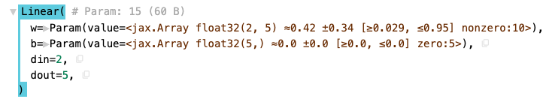
Flax NNX Python Graphs
Bridging JAX Power with Python Familiarity
nnx.display(Linear(2, 5, rngs=nnx.Rngs(params=0)))
Notes:
Here’s a simple example of an nnx.Module Python graph for a very simple linear model. Notice that the weights and biases are nnx.Params, while the dimensions are simple Python. By the way, notice that nnx.display() makes displaying a Python graph in a notebook really easy, and it’s very useful when you’re debugging!

Slide 11
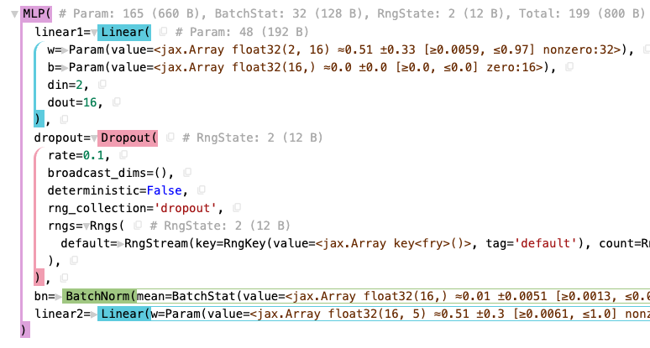
Notes:
Here’s a more complex example showing nested modules, forming the layers of a model. nnx.display() uses the treescope library, which allows you to explore Python graphs visually.

Slide 12
Data Structure: Python Graphs
Direct Attribute Access: Access layers and parameters like model.layer1, model.layer1.weight
Standard Python References: Assigning a layer to multiple attributes means they share the exact same object, just like in Python. Useful for weight sharing!
Mutability: Module state can be modified directly
Notes:
Accessing these submodules or parameters later is also standard Python attribute access: model.layer1 or model.layer1.weight. And importantly, standard Python reference semantics work exactly as you'd expect. If you create a layer and assign it to two different attributes – maybe for weight sharing between an encoder and decoder – both attributes will point to the exact same layer object in memory. There's no hidden copying or unexpected behavior here; it works just like Python references always do. So, structurally, defining your models in NNX can feel quite similar to PyTorch. Now, let's dive into how state, like the actual weights and biases, is managed within these objects.

Slide 13
Python Graphs in Practice: Like torch.nn.Module but for JAX
Handling State:
Static Config: Regular Python attributes
e.g., self.dropout_rate = 0.5
Dynamic State (Parameters/Buffers): Stored in special nnx.Variable container objects
e.g., nnx.Param for trainable weights
Access the actual JAX array data via .value
e.g., self.weight.value
Notes:
State management is explicit. Static configuration, like hyperparameters (dropout rates, hidden sizes), are just stored as regular Python attributes. The dynamic state – things that change or are learned, like weights (parameters) or BatchNorm statistics (buffers) – are held within special container objects, primarily nnx.Variable and its subclass nnx.Param for trainable parameters. Think of nnx.Param as analogous to torch.nn.Parameter. You access the underlying JAX array using the .value attribute.

Slide 14
Flax NNX Python Graphs
Bridging JAX Power with Python Familiarity
Why Python Graphs?
Mutability: Allowing objects (like model layers) to change their internal state directly.
Reference Sharing: Ensuring that if you assign the same layer object to multiple places in your model, it's truly the same object instance.
nnx.Param
nnx.Module
Python static
nnx.Module
nnx.Param
nnx.Module
Python static
Notes:
Crucially, these nnx.Variable objects allow for mutability. If a layer needs to update its internal state during the forward pass, like BatchNorm does, it can directly assign a new value to the .value attribute of its state variable. This is a key difference from the typically immutable style often used with JAX PyTrees.
And as mentioned, reference sharing works exactly as you'd expect in Python. If you create a layer or a parameter variable and assign it to multiple attributes or parts of your model, they all point to the very same object in memory. This is essential for patterns like weight sharing, and Python graphs handle it naturally.

Slide 15
Python Graphs in Practice: Like torch.nn.Module but for JAX
Reference Sharing:
Assigning the same module or nnx.Variable instance to multiple attributes creates shared references, identical to Python's standard behavior
shared_layer = nnx.Linear(...)
model.encoder_layer = shared_layer
model.decoder_layer = shared_layer # Both point to the same layer.
Notes:
Here’s an example which demonstrates reference sharing, exactly what you’d expect in Python.

Slide 16
Variable Types
Variables are wrappers over jax.Arrays that enable state updates and allow associated metadata.
nnx.Param: Learnable parameters of the model (dynamic state).
nnx.BatchStat, nnx.Cache, nnx.Intermediate: For specialized state.
Also nnx.State (not a Variable type): A pytree that contains a pure version of the object's state.
Notes:
NNX provides different types of variables to manage different aspects of your model's state. nnx.Param is for learnable parameters, nnx.State is for mutable variables that change during the forward pass.

Slide 17
Code Example: Stateful Parameter Layer
from flax import nnx
import jax.numpy as jnp
class StatefulParameterLayer(nnx.Module):
def __init__(self, initial_value: float, *, rngs: nnx.Rngs):
self.weight = nnx.Param(jax.random.uniform(rngs.params()))
self.bias = {'bias': jnp.array(initial_value)}
def update_bias(self, new_value: float):
self.bias['bias'] = jnp.array(new_value)
def __call__(self, x: jax.Array):
return x * self.weight.value + self.bias['bias']
Notes:
This example demonstrates the use of both nnx.Param and standard Python containers. weight is a learnable parameter, while bias is a Python dictionary that can be updated.

Slide 18
Explicit Random Number Generation
Uses nnx.Rngs object.
Requires explicit passing of a PRNG key when instantiating modules with randomness.
Promotes reproducibility and easier parallelization.
Layers store a forked copy of RNGs, ensuring state isolation.
Notes:
JAX requires explicit handling of random numbers, and NNX provides the nnx.Rngs object to manage this. This is crucial for reproducibility. But NNX 0.11 makes this even more robust. When you pass an Rngs object to a layer, like nnx.Linear, the layer doesn't just hold a reference to the original; it creates its own unique forked copy of the RNG state. This might seem like a small detail, but it's a huge win for preventing subtle bugs. It means that two layers can't accidentally use and advance the same RNG stream, which makes building complex, vectorized, or scanned models much safer and more predictable.

Slide 19
Eager Parameter Initialization
Parameters are initialized immediately when an nnx.Module is instantiated.
All shape information must be provided during initialization.
No implicit shape inference.
Notes:
NNX uses eager parameter initialization. This means that when you create a module, its parameters are immediately initialized. You also need to provide all shape information upfront.

Slide 20
Functional API: split, merge, update
nnx.split: Decomposes an nnx.Module into its static structure (GraphDef) and dynamic state (State).
nnx.merge: Reconstructs an nnx.Module from its GraphDef and State.
nnx.update: Updates an existing object in-place with the content of a given State.
Notes:
NNX also provides a Functional API with split, merge, and update. These functions allow you to separate a module's architecture from its parameters, which enables interoperability with pure JAX transformations.

Slide 21
Code Example: Counter with Functional API
class Counter(nnx.Module):
def __init__(self):
self.count = 0
def __call__(self):
self.count += 1
return self.count
counter = Counter()
print(f'{counter() = }') # 1
graphdef, state = nnx.split(counter)
@jax.jit
def count(state):
counter = nnx.merge(graphdef, state)
counter() # 2
return nnx.state(counter)
state = count(state)
nnx.update(counter, state)
print(f'{counter() = }') # 3
Notes:
This example demonstrates the Functional API. We use nnx.split to separate the module's structure and state, and nnx.merge to reconstruct it. The counter's state is preserved.

Slide 22
nnx.jit: When to Use NNX's Supercharger
What it does: nnx.jit ("Just-In-Time" compilation) takes your Python function and uses XLA to compile it into highly optimized code for CPU/GPU/TPU.
Think: Similar goal to torch.compile() – speed up execution.
The Catch: You shouldn't just jit() every function! Performance gains come from JITting the right functions.
Key Requirement #1: nnx.jit works best on Pure Functions. We'll define this next.
Goal: Identify the computationally heavy, pure parts of your code and jit() those.
Notes:
Both JAX and NNX offer jit(), and as we’ve discussed this is key to getting speedups. Think of jit() like NNX's version of torch.compile, but quite a bit faster – it analyzes your Python code and compiles it down to highly optimized machine code using XLA, targeting your specific hardware. The performance gains can be substantial. However, and this is crucial, the advice isn't to just put nnx.jit() on every single function you write. To get the most benefit, you need to be selective. The primary requirement for a function to be a good candidate for jit() is that it should be what we call a 'Pure Function'. Let's break down exactly what that means, because it's fundamental to using jit() effectively.

Slide 23
nnx.jit: NNX's Supercharger
import jax
import jax.numpy as jnp
from flax import nnx
import torch
jax_w = jnp.ones((3, 4))
jax_b = jnp.ones(3)
jax_x = jnp.ones(4)
pt_w = torch.ones((3, 4))
pt_b = torch.ones(3)
pt_x = torch.ones(4)
def jax_predict(W, b, x):
return jnp.matmul(W, x) + b
def pt_predict(W, b, x):
return torch.matmul(W, x) + b
Notes:
Let’s take a look at the performance that nnx.jit() gives us. We’ll start with some basic setup in JAX and PyTorch.

Slide 24
nnx.jit: NNX's Supercharger
jit_predict = nnx.jit(jax_predict)
def jax_batch(W, b, x):
for i in range(10000):
result = jax_predict(W, b, x)
def pt_batch(W, b, x):
for i in range(10000):
result = pt_predict(W, b, x)
%timeit pt_batch(pt_w, pt_b, pt_x) # PyTorch
%timeit jit_predict(jax_w, jax_b, jax_x).block_until_ready() # JAX with XLA compile
%timeit jit_predict(jax_w, jax_b, jax_x).block_until_ready() # NNX with jit()
79.9 ms ± 12.5 ms per loop (mean ± std. dev. of 7 runs, 10 loops each)
The slowest run took 6.12 times longer than the fastest. This could mean that an intermediate result is being cached.
79.4 µs ± 72.3 µs per loop (mean ± std. dev. of 7 runs, 1 loop each)
39.9 µs ± 756 ns per loop (mean ± std. dev. of 7 runs, 10000 loops each)
Notes:
Next we’ll create some simple loops, and time our code. We’ll use nnx.jit() on our JAX batch loop. When we first run it, XLA will compile it, so that will take some time. But even then we get 79.4 microseconds per loop, rather than 79.9 milliseconds per loop for PyTorch. And the second time we run it, since it’s already compiled and cached, it’s even faster - 39.9 microseconds per loop. That’s 79,400 microseconds compared to 39.9 microseconds, a speedup of almost 2,000X (1989X). This is the NNX version, which does extra stuff, and the pure JAX version is even faster.

Slide 25
nnx.jit: What is a "Pure Function"? (The Key to JIT)
Definition: A function is pure iff:
It always returns the same output for the same inputs
It has no side effects (we’ll talk about this next)
The Rule: Only apply nnx.jit to functions that are pure
(Good Practice: Writing pure functions is often good design anyway – easier to test and debug!)*
Notes:
What exactly makes a function 'pure'? It's a concept from functional programming, and it's pretty straightforward. A pure function essentially behaves like a mathematical function: give it the same inputs, and you always get the same output back. Critically, it doesn't do anything else besides compute that output. So the golden rule is simple: Only apply jax.jit or nnx.jit to functions that are pure. If your function just takes JAX arrays, does math on them, and returns JAX arrays, it's likely pure and a great candidate for jit(). Incidentally, aiming for pure functions is often good coding practice in general, as they tend to be much easier to understand, test, and debug.

Slide 26
nnx.jit: What is a "Pure Function"? (The Key to JIT)
What are Side Effects?
Actions that affect things outside the function's direct input/output:
Modifying global variables
Changing mutable inputs (e.g., appending to a list passed as an argument)
Printing to the console, writing to files (I/O)
Changing system settings, interacting with databases
Notes:
Side effects are actions that reach outside the function to interact with the wider world or program state. Common examples include modifying a global variable, or maybe appending an item to a list that was passed into the function – changing the original list. Even simple things like print statements are side effects, as are reading files or interacting with networks.

Slide 27
Another Reason Not to jit: Python Control Flow
The Scenario: Your function uses standard Python if, while, for loops where the condition or iteration depends directly on the value of an input argument.
# Example NOT ideal for direct jit()
def process_value(x, threshold):
if x > threshold: # Control flow depends on input values
return x * 2
else:
return x / 2
Notes:
There's one more common scenario where you should hesitate before applying jit(), even if the function is technically pure. This involves standard Python control flow – your basic if statements or while loops – where the decision about which code path to take, or how many times to loop, depends directly on the value of an input argument. Look at this simple example. The path taken depends entirely on whether x is greater than threshold.

Slide 28
Another Reason Not to jit: Python Control Flow
Why it's Problematic for jit():
JAX traces the function based on the shapes and types of inputs, not specific values (usually)
A standard Python if depending on a value creates a specific path during tracing
If you call the JITted function later with a value that takes a different path, JAX might error or need to recompile, which can be slow, losing the speed benefit
Notes:
Why is this a problem for jit()? Remember that JAX traces the function once to compile it. It does this based on the shapes and types of the inputs. But in the previous example the Python if statement needs the actual value of x and threshold during the trace to decide which branch to take. If you trace it with x > threshold, the compiled code essentially only knows about the x * 2 path. If you later call the same JITted function with an x that's less than the threshold, the compiled code is now incorrect for that input, which can lead to errors or costly recompilations. We’ll see ways to detect and prevent that in our debugging discussion.

Slide 29
Another Reason Not to jit: Python Control Flow
The Rule: Avoid JITting functions where standard Python control flow (if/while) depends directly on input values.
Strategy:
Isolate the pure, numerically intensive parts within the branches/loops into separate functions
jit() those smaller, pure functions
Keep the Python control flow logic outside the JITted functions
Notes:
What's the solution? Structure your code. Identify the pure calculations inside the if/else blocks or inside the loop body. Put those calculations into their own separate, pure functions. Apply nnx.jit() to those smaller functions. Then, keep the Python if or while logic in the outer function, which you don't jit(), and have it call your smaller, JITted functions as needed. This way, you get the performance boost on the heavy computations without confusing the JIT compiler with value-dependent Python control flow.

Slide 30

JAX Transformations & The Stateful Model Challenge
Standard JAX Transformations (jax.jit,jax.grad,jax.vmap)
Designed for pure functions:
No side effects (don't modify external state).
Deterministic output for the same input.
Operate on PyTrees (nested lists, dicts, tuples containing arrays).
Require explicit state management: You must manually pass state (like model parameters, optimizer state, RNG keys) into the function and return the updated state.
Notes:
JAX itself has its own transformations, like jax.jit() for compiling functions, jax.grad() for gradients, and jax.vmap() for vectorization. JAX’s transformations are also built for pure functions – functions that don't modify things outside their scope and always give the same output for the same input. They primarily work with data structures called PyTrees.

Slide 31
JAX Transformations & The Stateful Model Challenge
NNX Modules (and PyTorch Modules) are stateful:
NNX Modules (like torch.nn.Module) are inherently stateful. They contain their parameters and potentially other mutable state (e.g., BatchNorm stats).
Directly applying jax.jit() or jax.grad() to a method of a stateful object requires manually extracting the state, passing it through the pure function, and then updating the object with the returned state. This can be cumbersome.
Notes:
Now, think about how we typically build models in PyTorch or Flax NNX. Our modules (nnx.Module or torch.nn.Module) hold their own state – the parameters, maybe optimizer states, or RNG keys. They aren't stateless. So, there's a mismatch: JAX transformations want pure functions, but our model objects are stateful.
If you wanted to use plain jax.jit() on an NNX module's method, you'd have to manually pull out all the state (parameters, etc.), pass it into a pure function version of your method, get the updated state back, and then manually put it back into your module object. That's a lot of boilerplate code.

Slide 32
NNX Transformations
nnx.jit, nnx.grad, nnx.vmap
Wrappers around standard JAX transformations
jax.jit, jax.grad, jax.vmap, etc.
Specifically designed to work directly with NNX graph objects
nnx.Module, nnx.Optimizer, nnx.Rngs, etc.
Notes:
This is where NNX transformations come in. They are designed specifically to bridge this gap and work smoothly with stateful NNX objects. Think of nnx.jit(), nnx.grad(), and nnx.vmap() as specialized versions of their JAX counterparts. They are essentially wrappers that know how to interact with NNX objects like Modules, Optimizers, and RNG managers. They’re designed to be consistent with JAX's transformations, which makes them easy to use.

Slide 33
The Key Difference: Automatic State Management
JAX Transforms: Require YOU to handle state explicitly (pass in, get back).
# Simplified JAX pattern
params, opt_state = ...
grads, new_state = jax.grad(loss_fn, has_aux=True)(params, ...)
updates, opt_state = optimizer.update(grads, opt_state, params) # Pass opt_state in, get it back
params = apply_updates(params, updates)
NNX Transforms: Handle state lifting and updating automatically behind the scenes when applied to methods of NNX objects.
# Simplified NNX pattern
model, optimizer, rngs = ... # NNX objects holding state
@nnx.grad # Applied to a method or function working with NNX objects
def loss_fn_nnx(...): ...
grads = loss_fn_nnx(...)
optimizer.update(grads) # Updates parameters within model object directly
Notes:
The biggest difference is automatic state management. NNX transformations hide that complexity for you.
When you use nnx.grad() on a function or method that operates on NNX objects, or nnx.jit() a method of an nnx.Module, the NNX transformation layer automatically figures out what state is involved (parameters inside the module, state inside the optimizer), handles the process of making it compatible with the underlying JAX transformation (like temporarily splitting the object into state and structure), runs the JAX transformation, and then merges the updated state back into your NNX objects.

Slide 34
When to Use NNX vs. JAX Transformations
Use NNX Transformations (nnx.jit, nnx.grad, etc.) when:
You are working with NNX graph objects (nnx.Module, nnx.Optimizer, nnx.Variable, nnx.Rngs). This is the primary use case.
You want simplified state management and less boilerplate code.
You prefer a more object-oriented style where transformations apply directly to methods interacting with stateful objects.
Notes:
So, when should you use nnx.jit() versus jax.jit()?
The rule of thumb is straightforward: If you are working with NNX objects – your nnx.Modules, nnx.Optimizers, state variables like nnx.Param, or nnx.Rngs – use the NNX transformations (nnx.jit(), nnx.grad(), etc.). They are built precisely for this scenario. They will simplify your life by handling the state automatically and letting you write code that feels more naturally object-oriented.

Slide 35
When to Use NNX vs. JAX Transformations
Use Standard JAX Transformations (jax.jit, jax.grad, etc.) when:
You are working with pure functions that don't involve NNX objects or mutable state directly.
You are operating on plain PyTrees (e.g., data preprocessing functions).
You need fine-grained, low-level control over the transformation process and state handling (you want to manage state explicitly).
You need a specific JAX transformation feature that might not yet have an NNX counterpart (less common for core transforms).
Standard JAX transformations are faster
Notes:
When would you use the standard JAX transformations? You can still use them for functions that are naturally pure and don't involve NNX objects. For example, maybe you have some data loading or preprocessing functions that just operate on JAX arrays organized in PyTrees, and standard jax.jit() or jax.vmap() would be perfectly appropriate there. You might also use them if you need very low-level control over how state is passed around, or if you need a niche JAX transformation that doesn't have an NNX equivalent yet, though for the core ones like jit(), grad(), and vmap(), NNX has you covered. Finally, because the NNX transformations have to do extra work, the standard JAX transformations are a bit faster. jax.jit() for example can be about twice as fast as nnx.jit().

Slide 36
When to Use NNX vs. JAX Transformations
General Recommendation:
If you are using Flax NNX objects, use the corresponding NNX transformations. They are designed for this purpose and provide a much smoother experience.
Notes:
But the main takeaway is: for building and training models with Flax NNX, stick with the NNX transformations. They streamline the process significantly by abstracting away the complexities of state management required by the underlying JAX transformations.

Slide 37
Models

Slide 38
Fundamental Neural Network Layers
nnx.Linear
nnx.Conv
nnx.BatchNorm
nnx.LayerNorm
nnx.GroupNorm
nnx.MultiHeadAttention
nnx.LSTMCell
nnx.GRUCell
nnx.Dropout
Notes:
NNX provides a comprehensive set of fundamental neural network layers, including linear layers, convolutional layers, normalization layers, attention mechanisms, and recurrent cells.

Slide 39
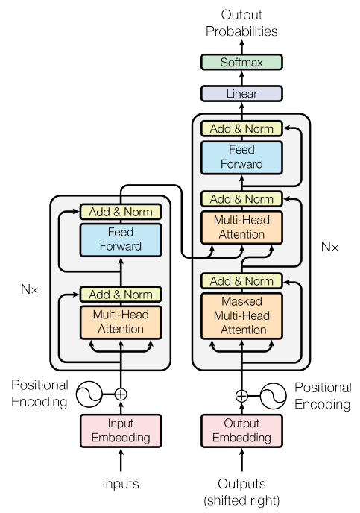
Building Complex Models
MLPs, CNNs can be easily constructed.
Requires explicit specification of input and output shapes during initialization.
Provision of an appropriate random number generator key for parameters.
Notes:
You can easily build more complex models by composing these fundamental layers. Remember that NNX requires you to specify input and output shapes and provide a random number generator key.

Slide 40
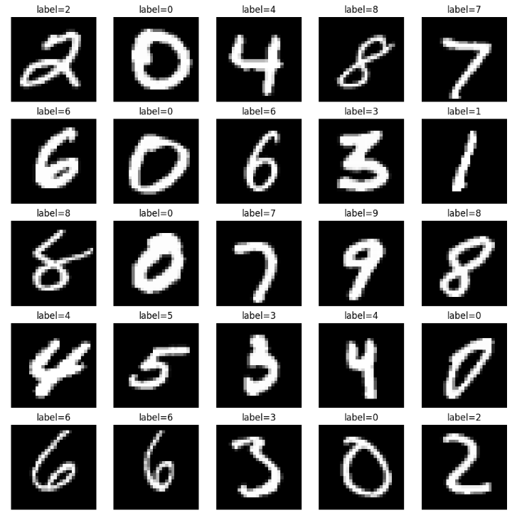
MNIST Tutorial
Example of defining a CNN for digit classification using Flax NNX.
Covers loading the MNIST dataset, defining the CNN model, creating an optimizer using Optax, defining the training loop, and evaluating the model.
https://flax.readthedocs.io/en/latest/mnist_tutorial.html
Notes:
The MNIST tutorial is a great starting point for learning NNX. It shows you how to define a CNN, train it using Optax, and evaluate its performance.

Slide 41
Flax NNX and the JAX AI Stack
Notes:
Let’s quickly review how Flax NNX fits into the JAX AI Stack

Slide 42
Flax NNX and the JAX AI Stack
JAX: Array operations and program transformations.
Flax NNX: Building neural networks.
Optax: Gradient processing and optimization.
Orbax: Checkpointing and persistence.
ml_dtypes: NumPy dtype extensions for machine learning.
Grain
Flax NNX | Orbax | Optax
JAX
XLA
CPU/GPU/TPU
https://docs.jaxstack.ai
Notes:
Flax NNX is an integral part of the JAX AI Stack, which is a curated collection of libraries that work well together for AI development with JAX. The JAX AI Stack includes JAX itself, Flax NNX for building neural networks, Optax for optimization, Orbax for checkpointing, and ml_dtypes for machine learning data types.

Slide 43
Comparing Flax NNX with PyTorch
Notes:
Now let’s do a detailed comparison of Flax NNX and PyTorch

Slide 44
Comparison with PyTorch: High-Level
Both use class-based structures for defining models.
Similarities in __init__ and forward pass methods (__call__ in NNX).
Key difference: explicit vs. implicit random number generation.
PyTorch, the PyTorch logo and any related marks are trademarks of The Linux Foundation.
Notes:
Both frameworks use a class-based structure, and there are similarities in how you define models. A key difference is the handling of random numbers, where NNX enables and requires explicit control.

Slide 45
Comparison: State Management
PyTorch: Imperative updates using zero_grad() and step().
Flax NNX: Direct attribute assignment and mutation, also enables a functional style with Functional API (split, merge).
PyTorch, the PyTorch logo and any related marks are trademarks of The Linux Foundation.
Notes:
State management is an area where the two frameworks differ. PyTorch is limited to imperative updates, while NNX also enables a more functional style using its Functional API.

Slide 46
Code Example: Shifted ReLU in PyTorch and NNX
# PyTorch
import torch
import torch.nn as nn
class ShiftedReLU_Torch(nn.Module):
def __init__(self, shift: float):
super().__init__()
self.shift = shift
def forward(self, x):
return torch.relu(x + self.shift)
# Flax NNX
from flax import nnx
import jax.numpy as jnp
class ShiftedReLU_NNX(nnx.Module):
def __init__(self, shift: float):
self.shift = shift
def __call__(self, x: jnp.ndarray):
return nnx.relu(x + self.shift)
Notes:
This code compares the implementation of a Shifted ReLU activation function. Notice the similar structure of defining modules in both frameworks.

Slide 47
Code Example: Simple Classifier in PyTorch and NNX
# PyTorch
import torch
import torch.nn as nn
class SimpleClassifier_Torch(nn.Module):
def __init__(self, input_size: int, num_classes: int):
super().__init__()
self.linear1 = nn.Linear( input_size, 10)
self.relu = nn.ReLU()
self.linear2 = nn.Linear(
10, num_classes)
def forward(self, x):
x = self.linear1(x)
x = self.relu(x)
return self.linear2(x)
# Flax NNX
from flax import nnx
import jax
import jax.numpy as jnp
class SimpleClassifier_NNX(nnx.Module):
def __init__(self, input_size: int, num_classes: int, *, rngs: nnx.Rngs):
self.linear1 = nnx.Linear( input_size, 10, rngs=rngs)
self.relu = nnx.relu
self.linear2 = nnx.Linear(
10, num_classes, rngs=rngs)
def __call__(self, x: jnp.ndarray):
x = self.linear1(x)
x = self.relu(x)
return self.linear2(x)
Notes:
Here's a comparison of a simple classifier implementation. Again, you can see the similarities in defining network architectures. Note the explicit passing of rngs in the NNX version.

Slide 48
Comparison: Training Loop & Backpropagation
PyTorch: loss.backward() for automatic gradient computation, optimizer updates parameters directly.
Flax NNX: nnx.value_and_grad to compute gradients and optimizer.update to update the model's state with computed gradients.
PyTorch, the PyTorch logo and any related marks are trademarks of The Linux Foundation.
Notes:
The training loop and backpropagation process differ more significantly due to JAX's functional programming style. JAX relies on automatic differentiation functions like jax.grad(), and makes the gradient calculation explicit.

Slide 49
Comparison: Training Loop & Backpropagation
# PyTorch
import torch
import torch.nn as nn
import torch.optim as optim
# Define a simple model
class SimpleModel_Torch(nn.Module):
def __init__(self):
super().__init__()
self.linear = nn.Linear(1, 1)
def forward(self, x):
return self.linear(x)
# Flax NNX
from flax import nnx
import jax
import jax.numpy as jnp
from optax import sgd
from typing import Any
# Define a simple model
class SimpleModel_NNX(nnx.Module):
def __init__(self, *, rngs: nnx.Rngs):
self.linear = nnx.Linear(1, 1, rngs=rngs)
def __call__(self, x: jnp.ndarray):
return self.linear(x)
Notes:
Let’s look at a code example. We start by setting up a very simple model in both PyTorch and Flax NNX.

Slide 50
Comparison: Training Loop & Backpropagation
# PyTorch
model_torch = SimpleModel_Torch()
optimizer_torch = \
optim.SGD(model_torch.parameters(), lr=0.01)
loss_fn = nn.MSELoss()
# Dummy data
x_torch = torch.tensor(
[[2.0]], requires_grad=True)
y_torch = torch.tensor([[4.0]])
# Flax NNX
model_nnx = SimpleModel_NNX(rngs=nnx.Rngs(0))
# Optimizer
optimizer = nnx.Optimizer(
model_nnx,
tx=sgd(learning_rate=0.01),
wrt=nnx.Param)
# Dummy data
x_nnx = jnp.array([[2.0]])
y_nnx = jnp.array([[4.0]])
Notes:
Then we instantiate the model, set up the optimizer, and create some dummy data. Notice one new, important detail in the nnx.Optimizer call: the wrt argument, which stands for 'with respect to'. Here, we explicitly tell the optimizer that it should be calculating gradients and applying updates with respect to nnx.Param variables. This makes the optimizer's intent crystal clear — it will only update the trainable parameters of our model.

Slide 51
Comparison: Training Loop & Backpropagation
# PyTorch Training step
# Zero the gradients
optimizer_torch.zero_grad()
output_torch = model_torch(x_torch)
loss_torch = loss_fn(
output_torch, y_torch)
loss_torch.backward() # Compute gradients
# Update parameters
optimizer_torch.step()
print("PyTorch Loss:", loss_torch.item())
# Flax NNX Training step
@nnx.jit
def train_step(model, optimizer, x, y):
def loss_fn(model):
return jnp.mean((model(x) - y) ** 2)
loss, grads = \
nnx.value_and_grad(loss_fn)(model)
# in-place updates
optimizer.update(model, grads)
return loss
# Pass the optimizer
loss_nnx = train_step(model_nnx,
optimizer, x_nnx, y_nnx)
print("Flax NNX Loss:", loss_nnx)
Notes:
This code compares the training loop and backpropagation process in PyTorch and Flax NNX. In PyTorch, you call loss.backward() to compute gradients and optimizer.step() to update parameters. In Flax NNX, you use nnx.value_and_grad() to compute gradients and optimizer.update() to update the model's state. The gradients are calculated explicitly and then applied to update the model.

Slide 52
Conclusion
Flax NNX provides a powerful and intuitive way to build neural networks with JAX.
NNX is Pythonic: Regular Python semantics for Modules, including support for mutability and shared references.
Notes:
Flax NNX is a compelling option for those looking to leverage the performance and flexibility of JAX. NNX is also Pythonic, since it uses regular Python semantics for Modules, including support for mutability and shared references.

Slide 53

Learning Resources
Code Exercises, Quick References, and Slides
https://goo.gle/learning-jax
Notes:
You can learn more about JAX and the entire JAX AI Stack with these coding exercises, quick reference docs, and slides.

Slide 54
Community and Docs
Community:
https://goo.gle/jax-community
Docs
JAX AI Stack: https://jaxstack.ai
JAX: https://jax.dev
Flax NNX: https://flax.readthedocs.io
Notes:
There’s a growing community on Discord for JAX, here’s an invite link, and here are links to the docs for JAX, Flax, and the JAX AI Stack.

